Slide 1

BUS421 – Marketing Research Assignment: Pricing Model
Nicholas Feng Schaefer

Slide 2
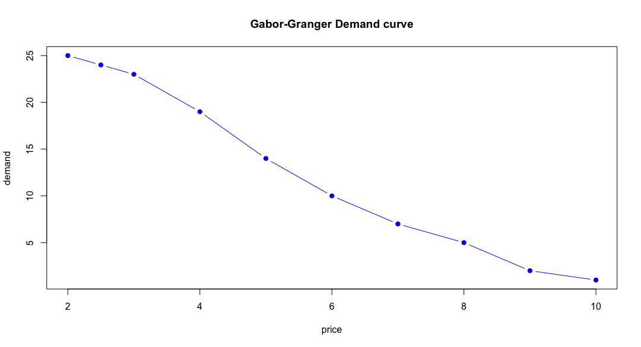
Gabor Granger – Demand Curve

Slide 3
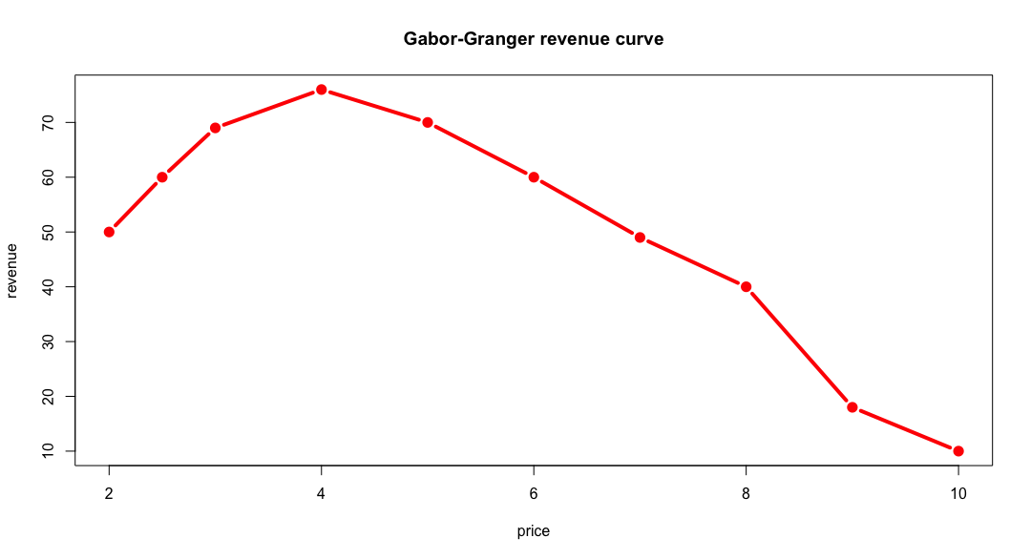
Gabor Granger – Revenue Curve

Slide 4
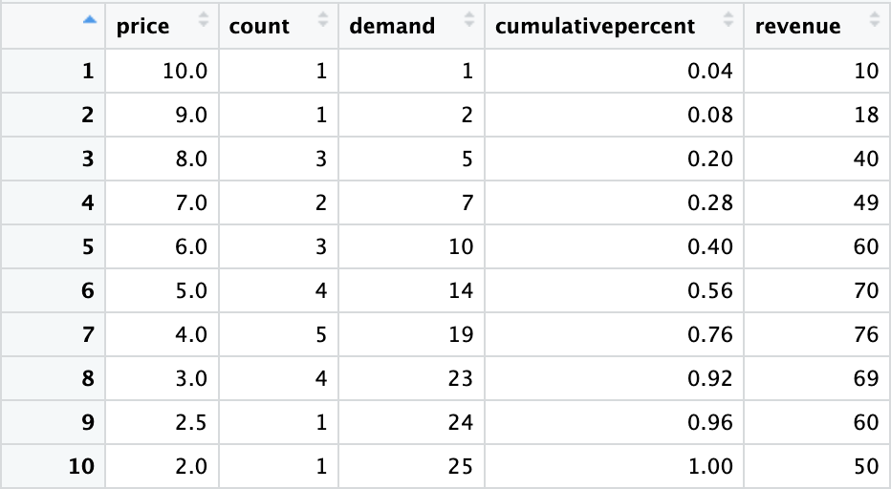
Gabor Granger – Optimal Price and Revenue
Both, the table and the revenue curve, show that at a price point of $4 the product will maximize revenue at $76
Optimal price: $4
Maximum revenue: $76
For a sample of 25 people

Slide 5
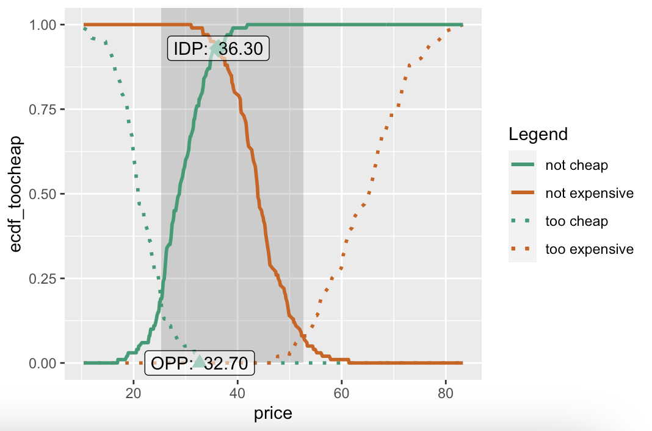
Van Westendorp – Plot

Slide 6
Van Westendorp – Acceptable Price
Acceptable price range:
Lower bound: Intersection of “Too cheap” and “Expensive” demand curves
Upper bound: Intersection of “Too expensive” and “Cheap” demand curves
In this case:
Lower bound: $25.3
Upper bound: $52.6

Slide 7
Van Westendorp – Optimal Price
Optimal price:
Intersection of “Too cheap” and “Too expensive” demand curves
The same amount think a product is too cheap and too expensive at this point
In this case:
Optimal price is at $32.7

